Slide 1
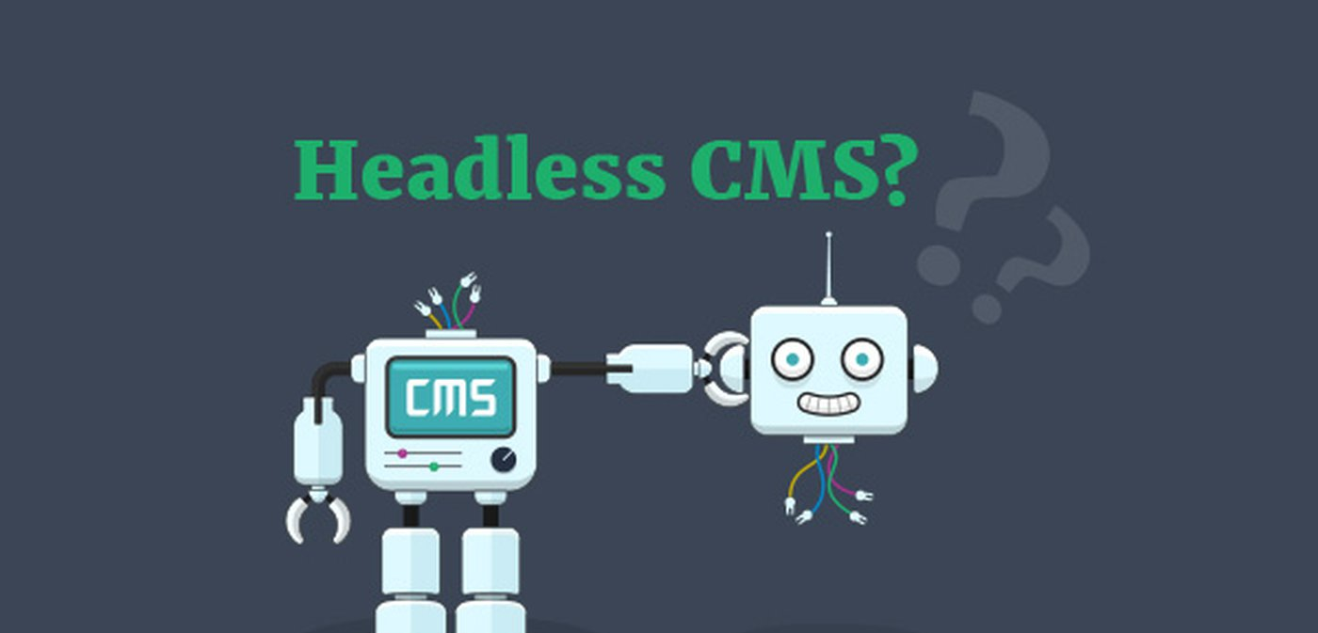

Slide 2
Topic
Anatomy of a CMS
What is a CMS ?
What is a Headless CMS ?
What is a Decoupled CMS ?
Compare CMS vs Headless CMS vs Decoupled CMS
Pros and Cons
Example

Slide 3
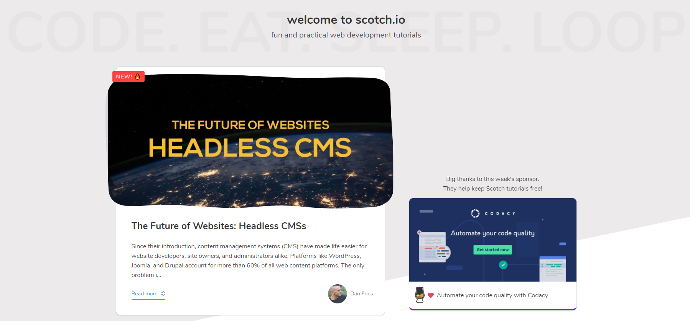

Slide 4

#Anatomy of a CMS
The traditional CMS is a monolithic structure which provides out of the box solutions for templating and styling that are customizable via a WYSIWYG. As a result, designers and website builders can create professional-looking sites without needing to write a single line of code.
As opposed to a traditional CMS, headless CMSes intentionally “chop off the head” thereby decoupling the front end from the back end. It therefore has no default frontend system and completely relinquishes the decision of presenting content to the developer.

Slide 5

#What is a CMS?
A content management system (CMS) is a software application or set of related programs that are used to create and manage digital content
content management systems have two components:
a content management application (CMA) and a content delivery application (CDA).
The CMA is a graphical user interface (GUI) that allows the user to control the creation, modification and removal of content from a website without needing to know anything about HTML.
The CDA component provides the back-end services that support management and delivery of the content once it has been created in the CMA.

Slide 6
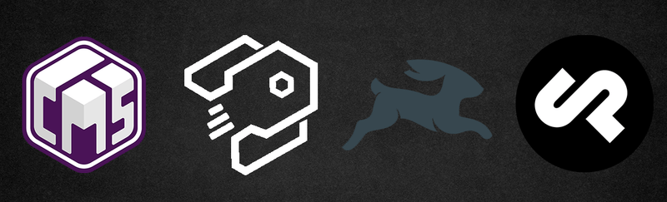
#What is a headless CMS?
Headless CMS - a content management system that contains only the back-end developer environment, with no default templating system or frameworks. These are a subset of decoupled CMSs.
Headless CMS architecture separates back-end content functions (like creation, management, and storage) from front-end functions (like presentation and delivery).

Slide 7

#What is a Decoupled CMS ?
Decoupled CMS – also known as a hybrid headless CMS - your content is managed separately and is front-end agnostic, just like a headless CMS. Yet, it has front-end delivery tools in the box, like templates, if you want to use them.

Slide 8
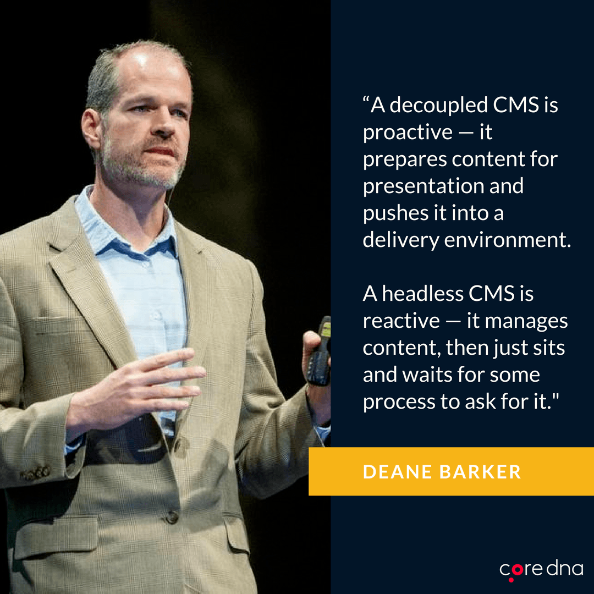

Slide 9

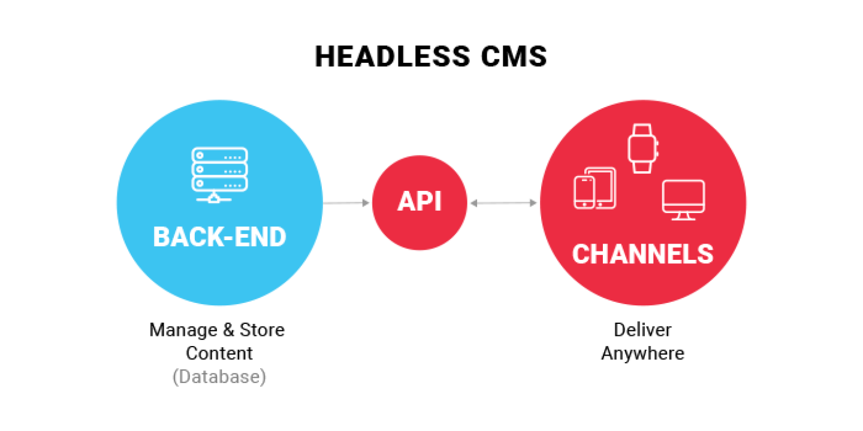
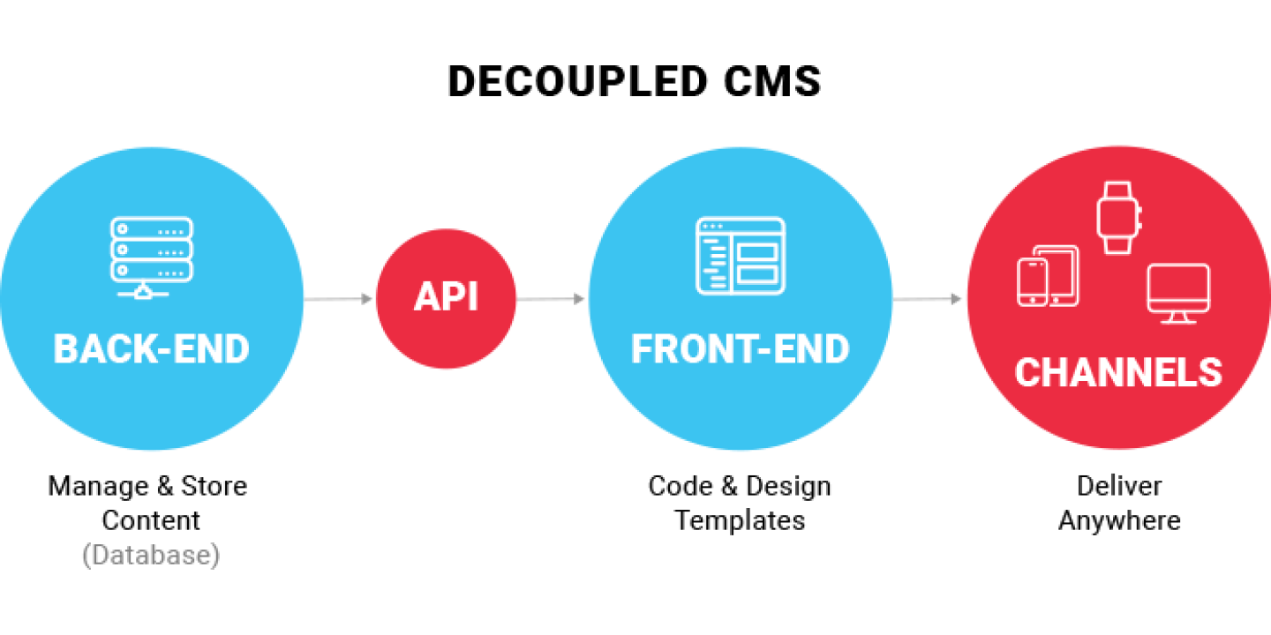
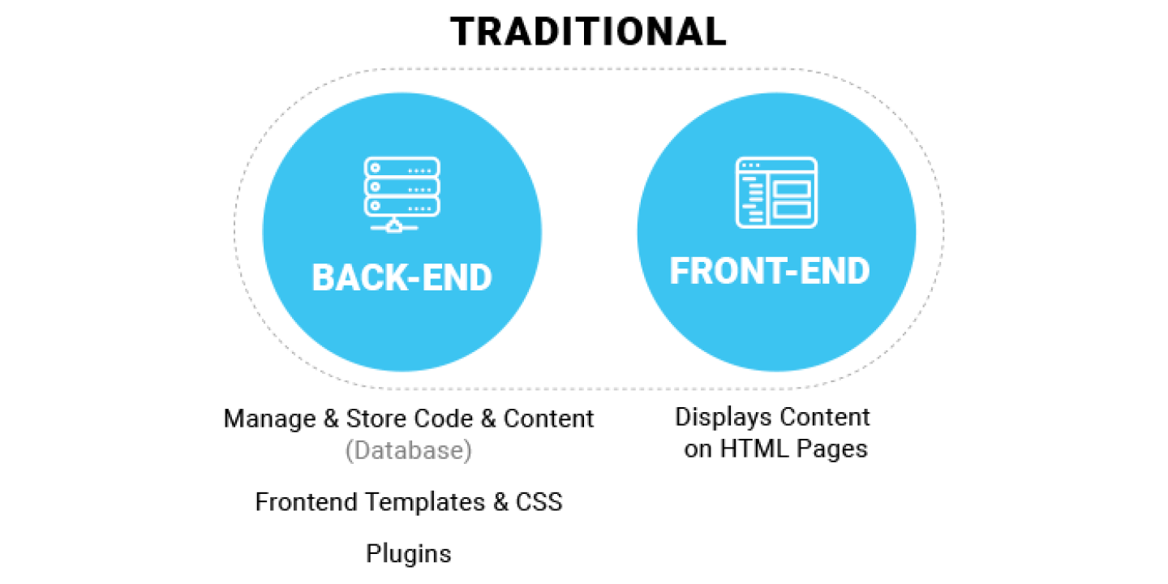
#Compare CMS vs Headless CMS vs Decoupled CMS

Slide 10
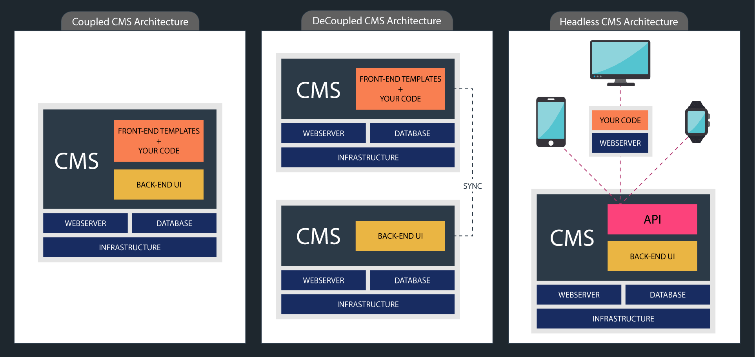

Slide 11
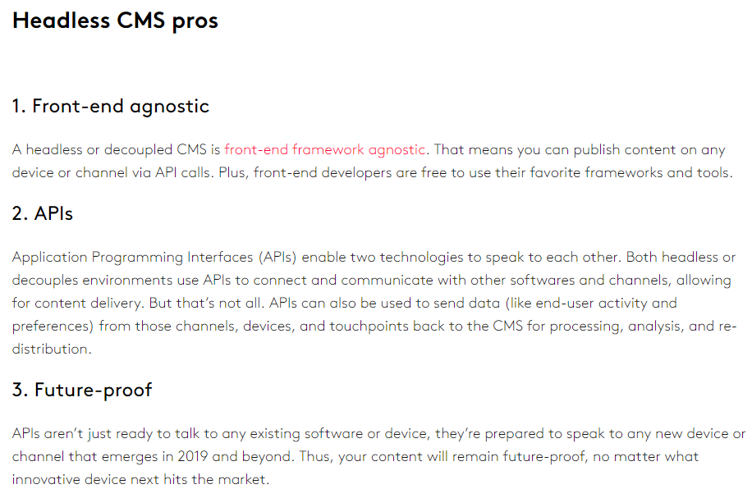
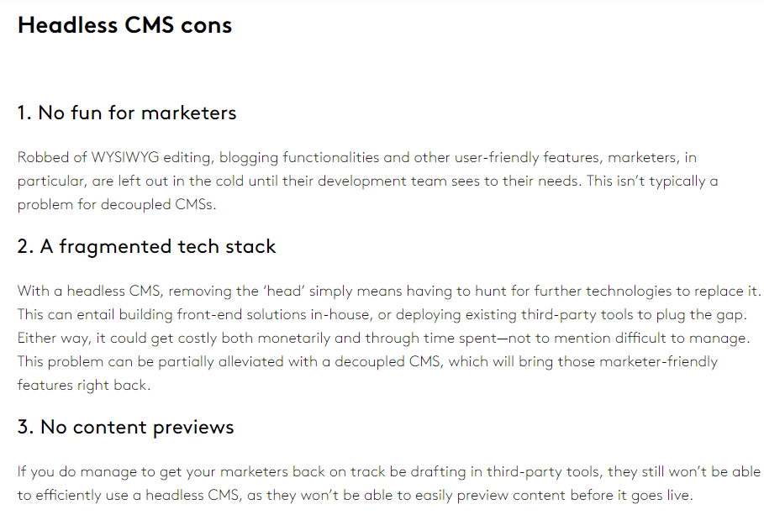
#Pros and Cons
https://www.coredna.com/blogs/headless-vs-decoupled-cms

Slide 12
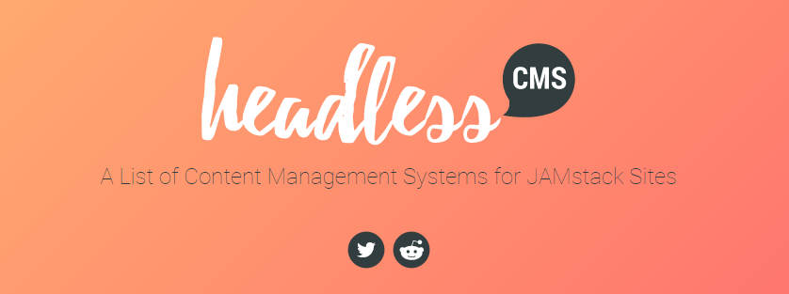
#Example

Slide 13

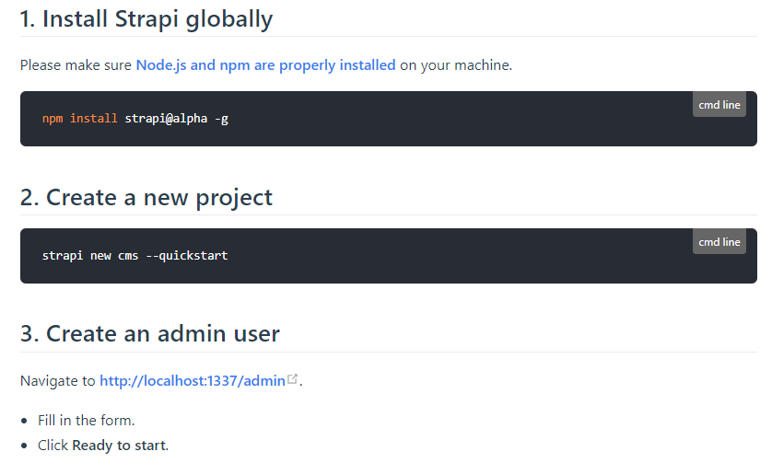
Notes:
npm install strapi@beta –g
strapi new my-project –quickstart
http://localhost:1337/admin.

Slide 14
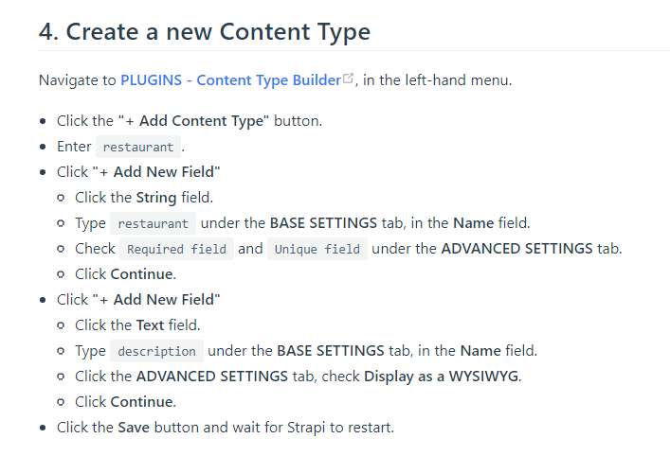
Notes:
1.Create content type restaurant
2.Create field name
3.Create field description

Slide 15
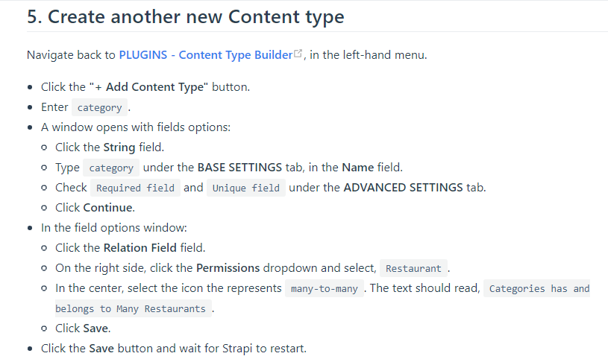
Notes:
1.Create content type category
2.Create field name
3.Create relation many-to-many

Slide 16
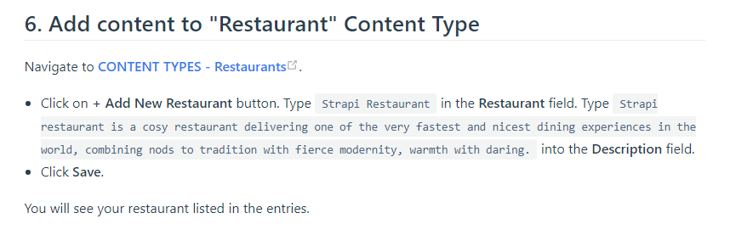
Notes:
Name: Strapi Restaurant
Description: Strapi restaurant is a cosy restaurant delivering one of the very fastest and nicest dining experiences in the world, combining nods to tradition with fierce modernity, warmth with daring.

Slide 17
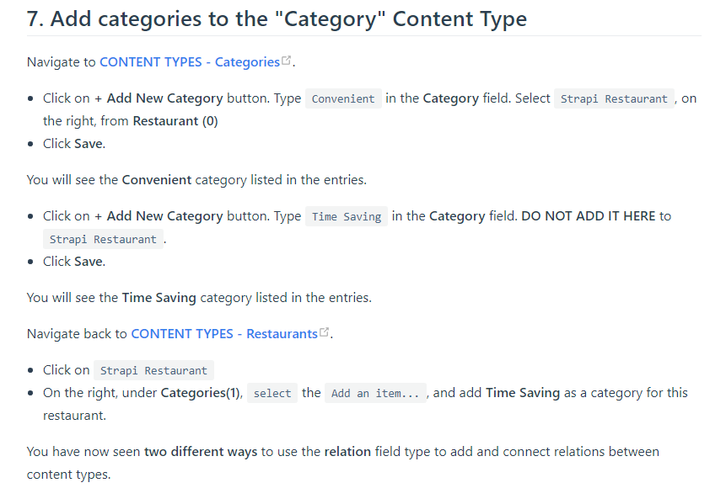
Notes:
Name: Convenient relatate strapi Restaurant
Name: Time Saving

Slide 18
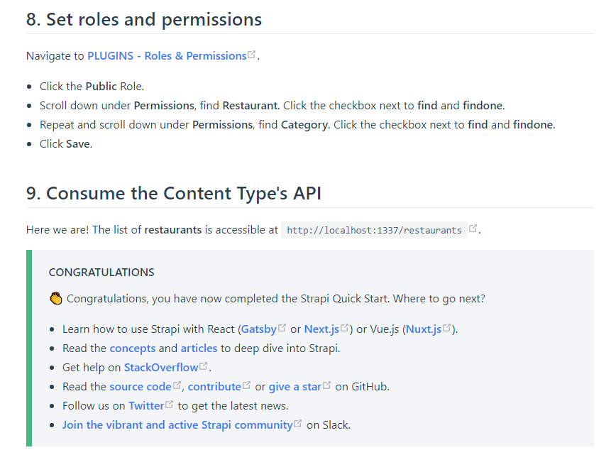
Notes:
http://localhost:1337/restaurants
https://blog.strapi.io/building-a-static-website-using-gatsby-and-strapi/

Slide 19


